Slide 1
CONDITION OF RAILWAYS TRACKS
Proposal Submitted for HackICAV’18
Problem Statement : Condition of Railway Tracks
Team Leader Name : Haarika Musunuru
Team members Name: Praveen S.
Arunkumar B.
MENTOR
Dr. R. Kishore, ASP/ECE, SSN CE

Slide 2
Objective
To propose a condition monitoring system that can detect faults before they intensify and improve safety
To identify sensors that will be suitable for detecting various faults in the railway tracks and configure those sensors into a system

Slide 3
Motivation
From the literature it is evident that 40% of Indian Railways tracks are used beyond capacity
Hence overworked tracks make train travel unsafe, which leads to the requirement for regular monitoring and maintenance of railway tracks.

Slide 4
Problem Statement
The Proposed condition monitoring system will be able to address the following issues:
Detect the crack in the railway track and at the same time inform the location of the crack in track, thereby avoiding major accidents (time of arrival concept can be used)

Slide 5
Problem Statement (Contd.,)
Detect the presence of mud holes, ballast for tamping and generate warning (Exploit the concept of difference in the actual distance between the presence and absence of mud holes with the help of ultrasonic sensors)

Slide 6
Problem Statement (Contd.,)
Detect defects in the internal structure of the railway bridge due to heavy loads passing on it (Ultrasonic sensor can be used)
At the same time the information regarding overloading the tracks can be detected using strain gauge concept

Slide 7
Problem Statement (Contd.,)
Sense the interlocking disabilities found on the track, may be due to unnecessary objects that makes the interlocking of tracks a difficult one (ultrasonic sensor can be used)

Slide 8



Block Schematic Representation
Detection Module
Wireless
Alert
Wireless
Inspection Bot
Master Control Station
Wireless
Ultrasonic sensor for internal damage detection of track.
Wireless
Detection Module
(Stress, load, Mud-holes)
Railway Track
Alarm
System

Slide 9
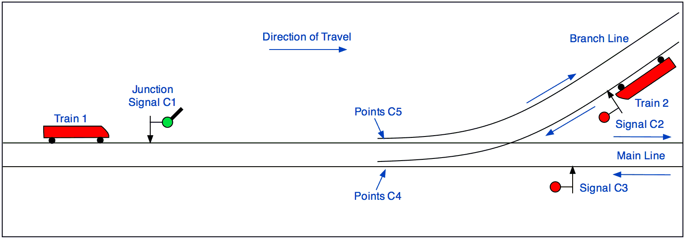
Schematic Representation
Sensor for detecting interlocking

Slide 10
Ultrasonic sensor
The ultrasonic sensors transmit sound waves and receives the reflected signal
The time-of-arrival of the reflected sound waves are used to find the distance of the obstacles
The same concept is used to find cracks and mud-holes in the track

Slide 11
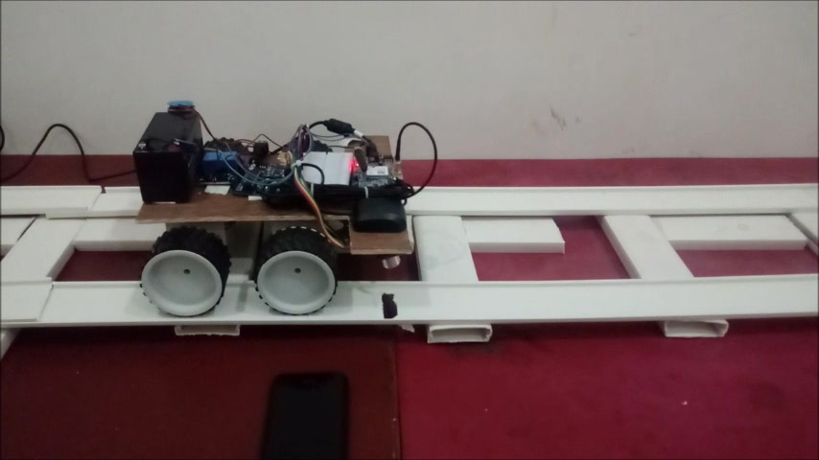
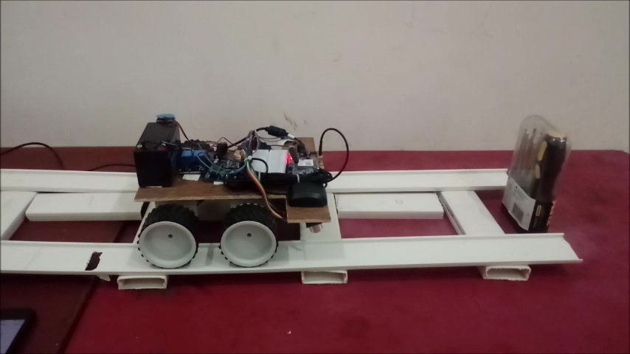
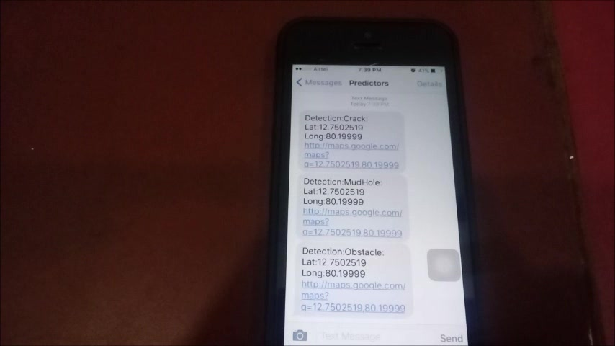
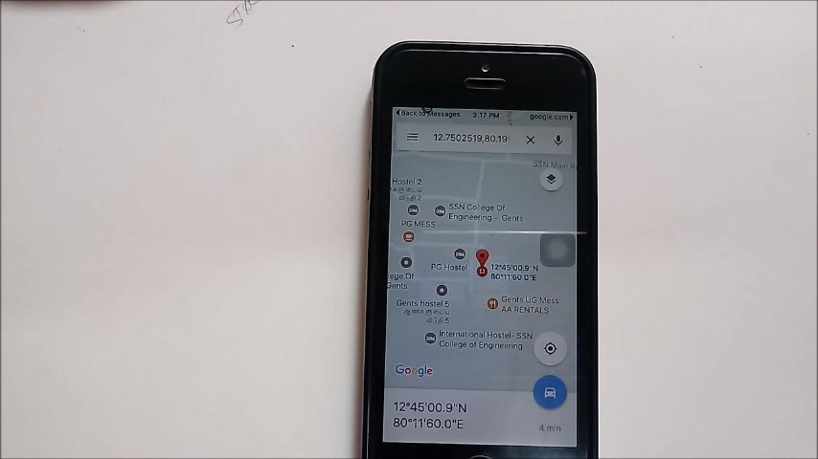
Contribution

Slide 12
Summary
Our contributions are:
Used ultrasonic sensor to identify
crack in the tracks
Mud-holes
Obstacles in front of train
Used strain gauge to find stress in railway tracks
Used GPS-GSM module to precisely locate and inform the problems in railway tracks to neighbor stations
The working model is designed and in proper working condition

Slide 13
References
B.Siva Rama Krishna, D.V.S Seshendra, G.Govinda Raja, T.Sudharshan and K.Srikanth, “Railway Track Fault Detection System by Using IR Sensors and Bluetooth Technology”, Asian Journal of Applied Science and Technology (AJAST) Volume 1, Issue 6, Pages 82-84, July 2017
R Swetha, S. Kayalvizhi, “Crack Detection System for Railway Tracks by Using Acoustic Emission Sensor”, International Journal of Mechanical and Industrial Technology, Vol. 5, Issue 1,pages(70-77), Month: April - September 2017
Victoria J. Hodge, Simon O’Keefe, Michael Weeks, and Anthony Moulds “Wireless Sensor Networks for Condition Monitoring in the Railway Industry: A Survey”, IEEE transactions on intelligent transportation systems, vol. 16, no. 3, Pages 1088-1106, June 2015.

Slide 14
References
Disha Bhat, Nayankumar Khatawkar,Neelavva Kadli,Dheeraj Veergoudar, “An Inspection System for Detection of Cracks on the Railway Track using a Mobile Robot”, International Journal of Engineering Research & Technology (IJERT), Vol. 4 Issue 05, Pages 603-606, May-2015
Eduardo Cañete *, Jaime Chen, Manuel Díaz, Luis Llopis and Bartolomé Rubio , “Sensor4PRI: A Sensor Platform for the Protection of Railway Infrastructures”, Sensors 2015, Issue 15, Pages 4996-5019, 27 February 2015

